Slide 1
Middle ages

Slide 2
500-1400
Also known as the medieval period
During this time period, we see a lot of growth in population. That all changed however when the Black death plague struck, wiping out about a third of the population.
Many advancements of technology were formed during this time as well.

Slide 3
Durham Cathedral
Located in Durham, England, this cathedral symbolizes the modern architecture in this time period.

Slide 7
Notre Dame
Located in Paris, France, this cathedral symbolizes modern French gothic architecture. Most of the church was damaged, however, during the French revolution. It is one of the most well known cathedrals to this day. Also, the first building to use flying buttresses.

Slide 9
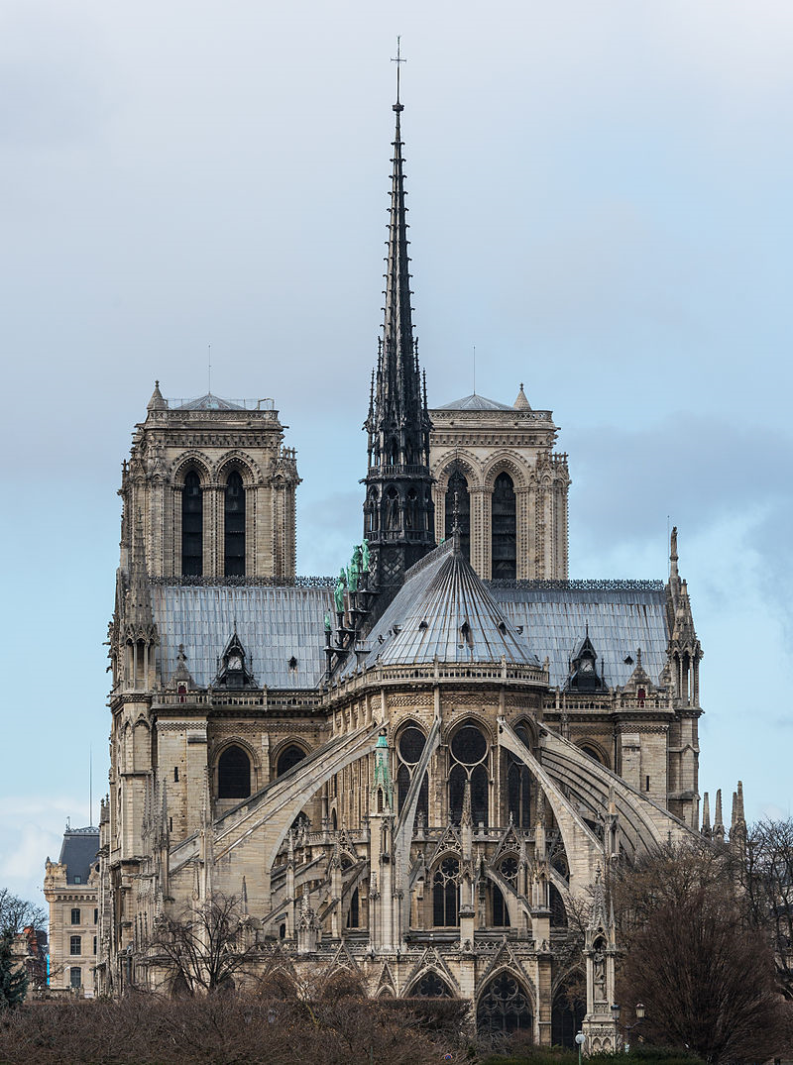

Slide 10
